Slide 1
Frontend Developer Portfolio – Odilov Sukhrobbek
My UI/UX projects

Slide 2
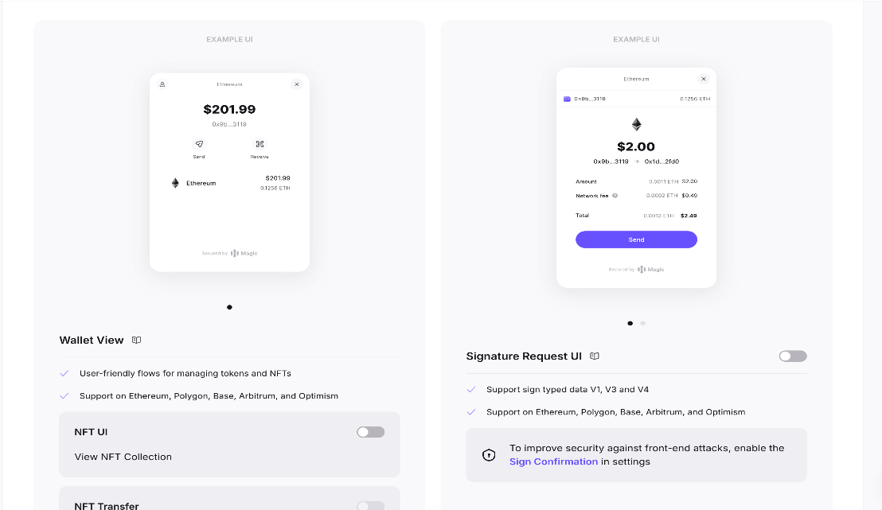
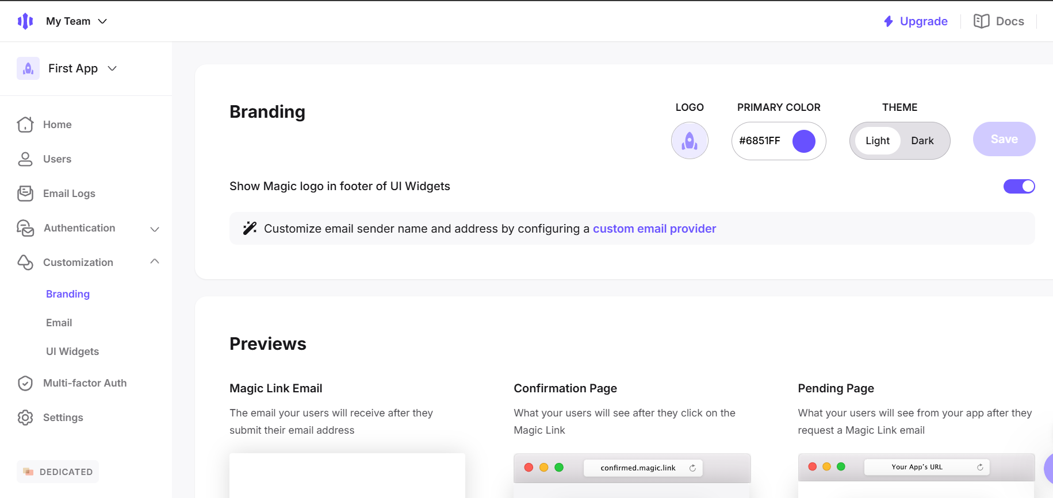
Magic Labs Projects
During my time working on Magic Labs products, I had the opportunity to implement high-performance frontends for several Web3 projects, each serving a unique purpose. These projects required deep integration with blockchain technology, a strong focus on scalability, and seamless user experience design. I developed responsive and interactive user interfaces using React.js, Next.js, and TypeScript, ensuring smooth and efficient application performance. Moreover, I built an intermediary events controller to facilitate real-time blockchain interactions, ensuring data integrity and accuracy.
Github: https://github.com/sukhrobfullstackdev/mandrake

Slide 3
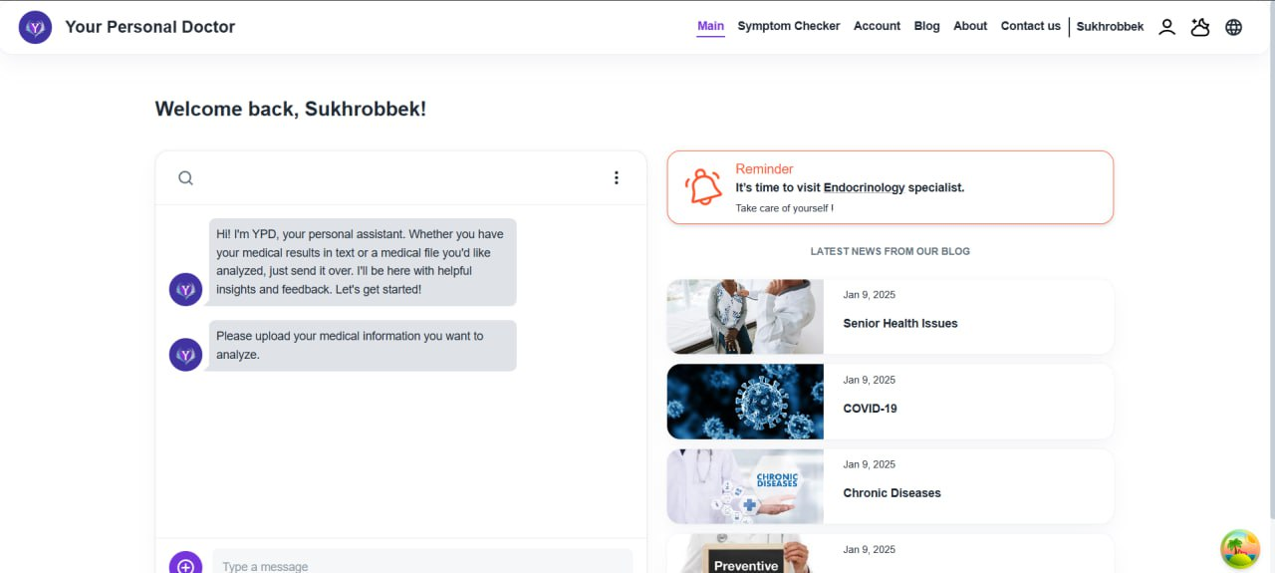
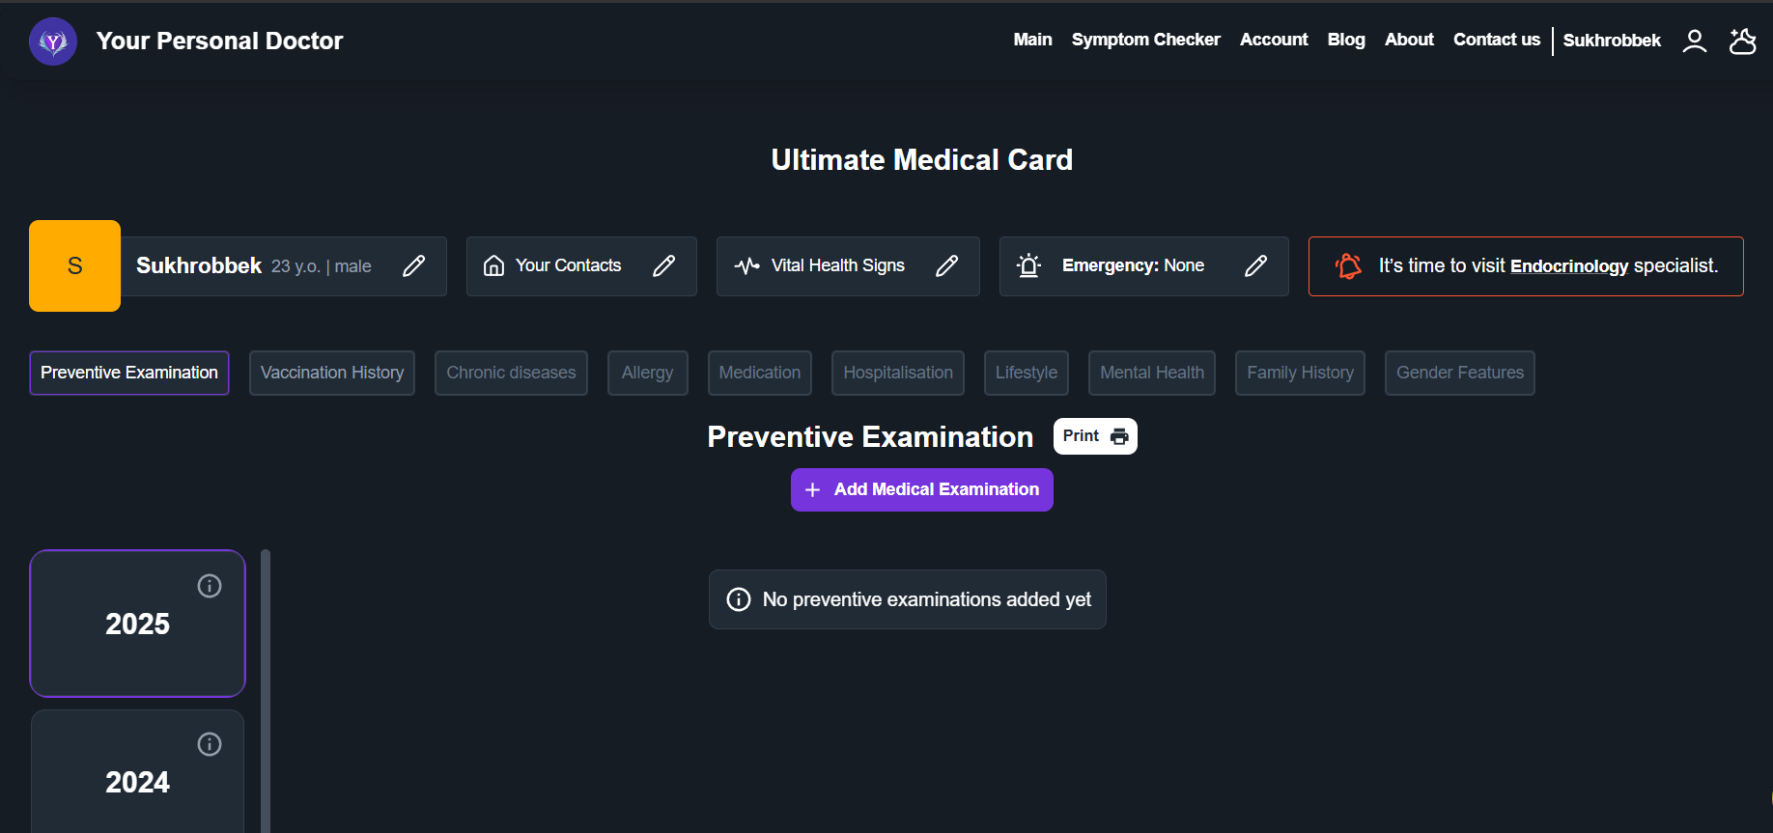
Your Personal Doctor (YPD) – AI-Powered Health Assistant
I had the opportunity to develop Your Personal Doctor (YPD) as a full-stack application with AI-powered integrations, designed to assist users in analyzing medical data, tracking health conditions, and providing valuable health insights. The platform combines modern web technologies with intelligent automation, ensuring an intuitive healthcare experience. In addition, I built the platform from scratch, implementing both the frontend and backend to ensure a best experience. Plus, I integrated AI to assist users in interpreting medical reports, symptom analysis, and personalized recommendations.
GitHub: https://github.com/sukhrobfullstackdev/your-pocket-doctor
Design:https://www.figma.com/design/UVSLmiHu25UnNPbuMqhUno/YPD_Health_Tech

Slide 4
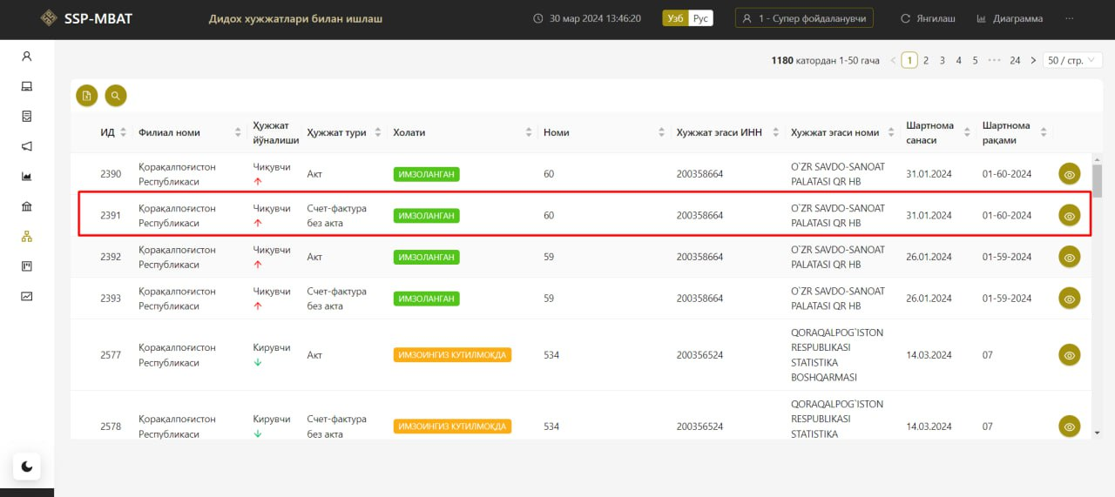
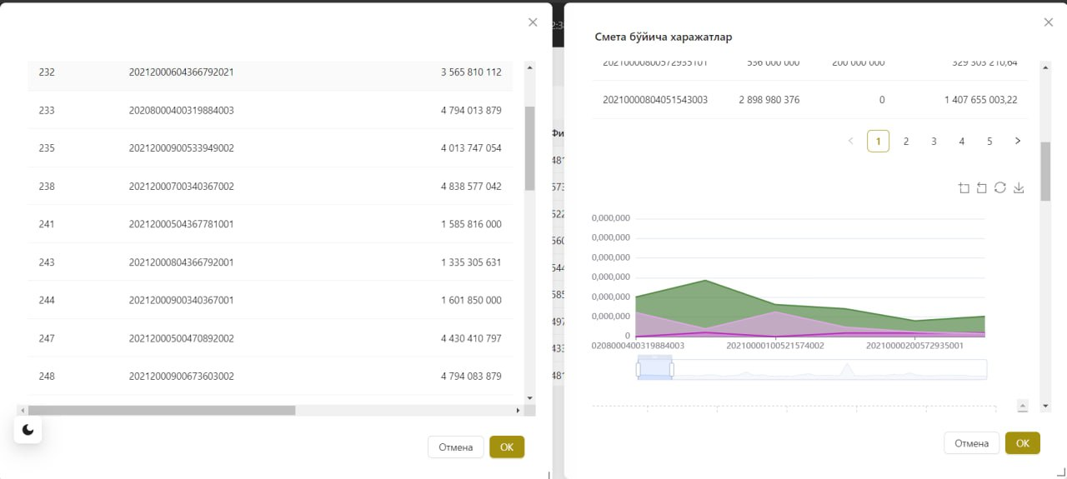
I have implemented a frontend and design governmental system.
Github: https://github.com/sukhrobfullstackdev/uzasbo_balans_front-dev

Slide 5
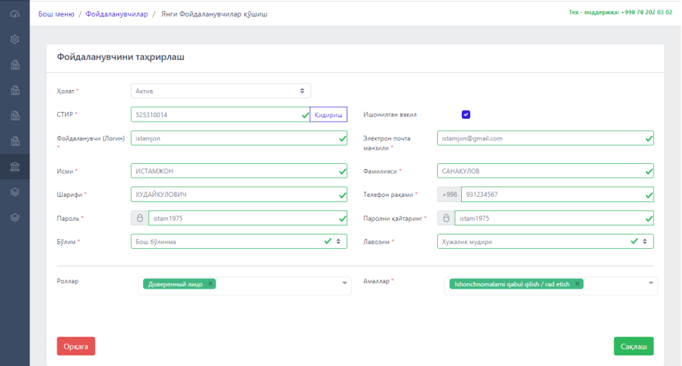
GitHub: https://github.com/sukhrobfullstackdev/uzasbo_zp_front
For more projects on other fields and stacks, visit my Github: https://github.com/sukhrobfullstackdev.

